Slide 1

Xamarin XAML
How to XAML from a Web Developer

Slide 2

Jon Ash
Joined HMB 2.5 years ago
Married with 3 Children
Hiking and Camping
All Kinds of Strategy Games (Chess to Fantasy Sports)
Primarily Web Developer
No Native Mobile Experience

Slide 3
Overview
MV * Patterns
MVC
MVP
MVVM
XAML
Basics
Navigations
Layouts
Data Binding and View Refresh

Slide 4
MV * Patterns
Not an Architectural Patterns
Compound Design Patterns
Specifically focus on the UI

Slide 5
Model View Controller (MVC)
Acts
User
Sees
Formatting
Event Handling
Controller
Broadcasts
View
Notifications
Callbacks
Observers
Etc
Rendering
Calls
Model
Observes
Hook for Business Logic
Traditional

Slide 6
Model View Controller (MVC)
Acts
User
Sees
Formatting
Event Handling
Controller
View
Model
(Data Structure)
Hook for Business Logic
Rendering
Calls
Model
Business Logic
.NET MVC

Slide 7
Model View Presenter (MVP)
User
Rendering
Sees
Acts
View
Business Logic
Event Handling
View Data
(Data Structure)
Events
<View>
Model
Calls
Presenter
Formatting

Slide 8
Model View View Model (MVVM)
User
Rendering
Sees
Acts
View
Business Logic
Binder (XAML)
Events
Model
Calls
View Model
Formatting
Event Handling

Slide 9
XAML
Extensible Application Markup Language
Initial Release was June 2008
Way to define the look and feel through templates
There can be slight variation in usage across tech stacks
We are focused on Xamarin Forms XAML

Slide 10
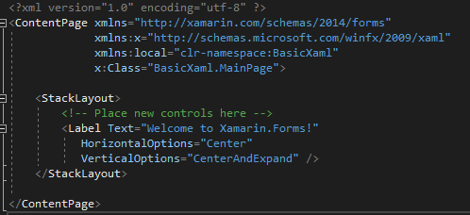
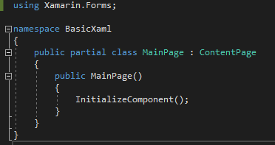
Anatomy
Two parts combine to form a single class
MainPage.xaml The XAML template file
MainPage.xaml.cs The C# code-behind associated with the template file
MainPage.xaml
MainPage.xaml.cs

Slide 11
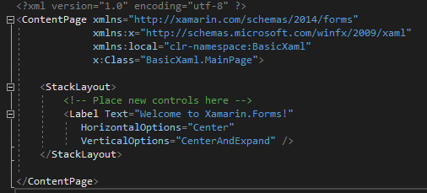
Digging into the XAML File
<ContentPage>
xmlns:local
Allows namespace declaration to other classes from the .NET Standard library project
x:Class
Fully qualified backing class

Slide 12
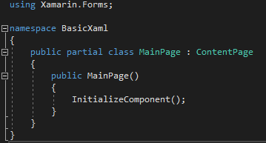
Digging into the Code-Behind File
POCO
Partial Class
Inherits from ContentPage
Constructor calls InitializeComponent()
At Runtime calls
LoadFromXaml which initializes all the objects defined in the XAML file, establishes their relationships and attaches the event handlers

Slide 13
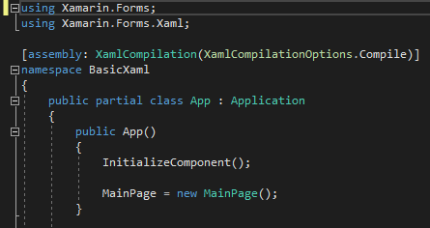
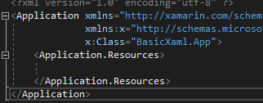
Special Case (App.Xaml)
<application>
Inherits Application
MainPage = new MainPage();
App.xaml
App.xaml.cs

Slide 14
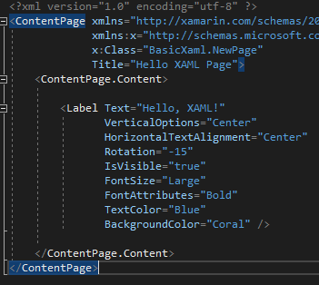
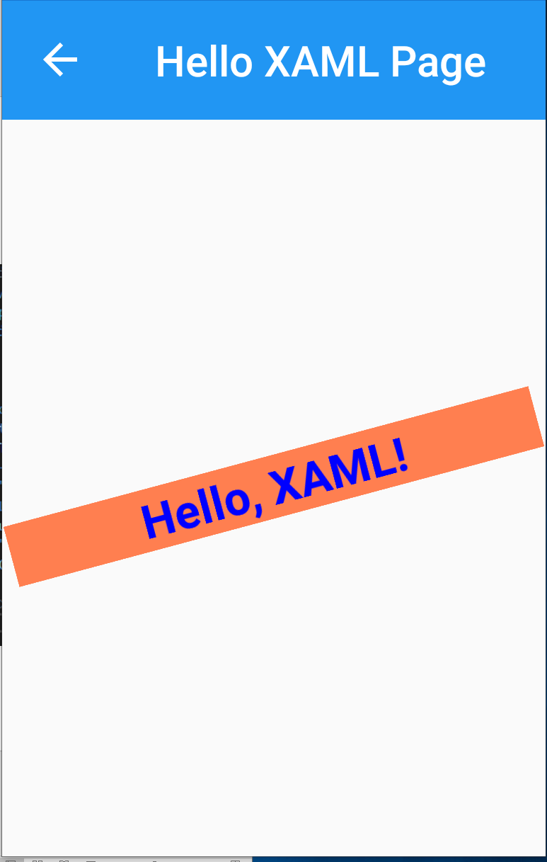
Creating Some Content
Title - In root tag
Basic tag attributes
Text
VerticalOptions
HorizontalTextAlignment
Rotation
IsVisable
FontSize
TextColor
BackgroundColor
ContentPage.Content can only have one child element

Slide 15
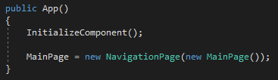
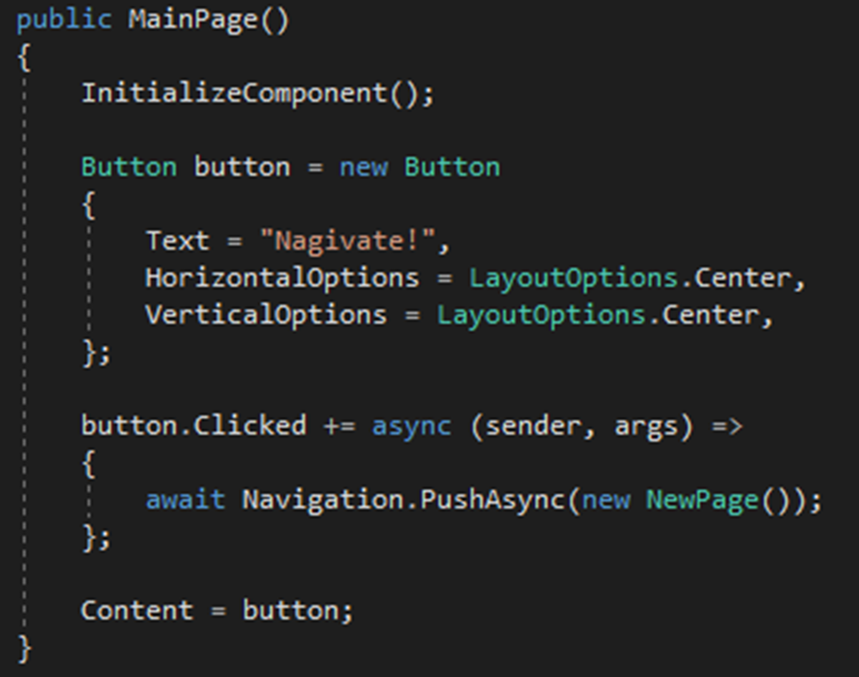
Navigation
MainPage MUST be a NavigationPage
await Navigation.PushAsync() is used to tell Xamarin to load new page.

Slide 16
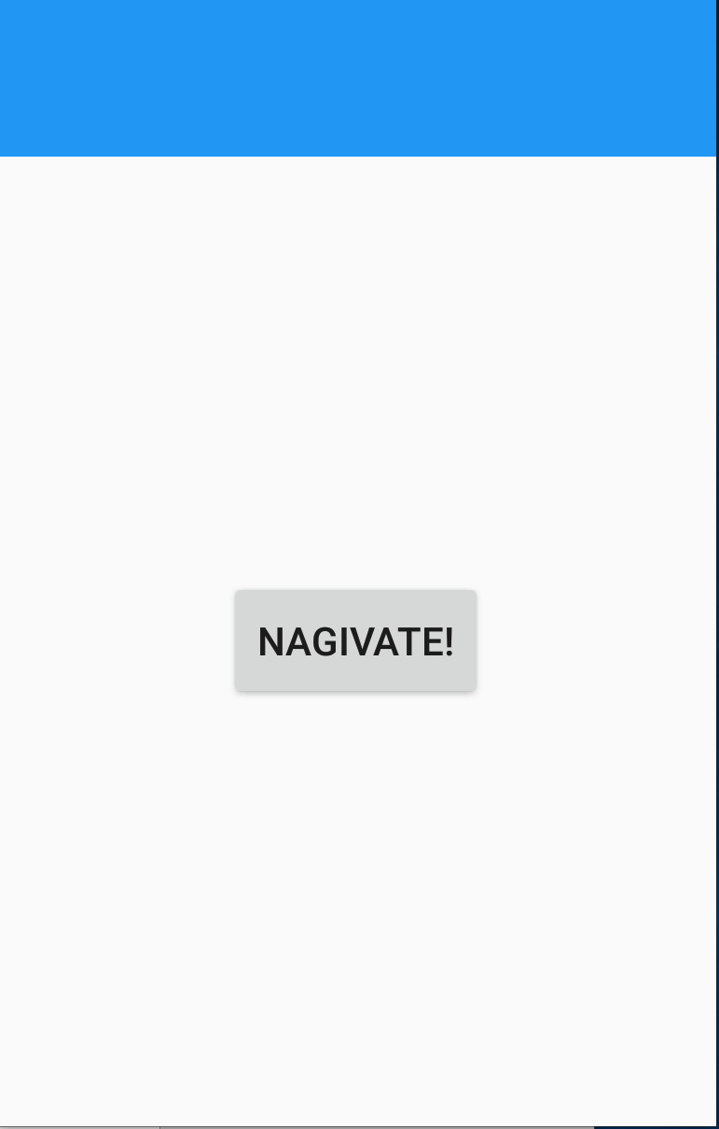
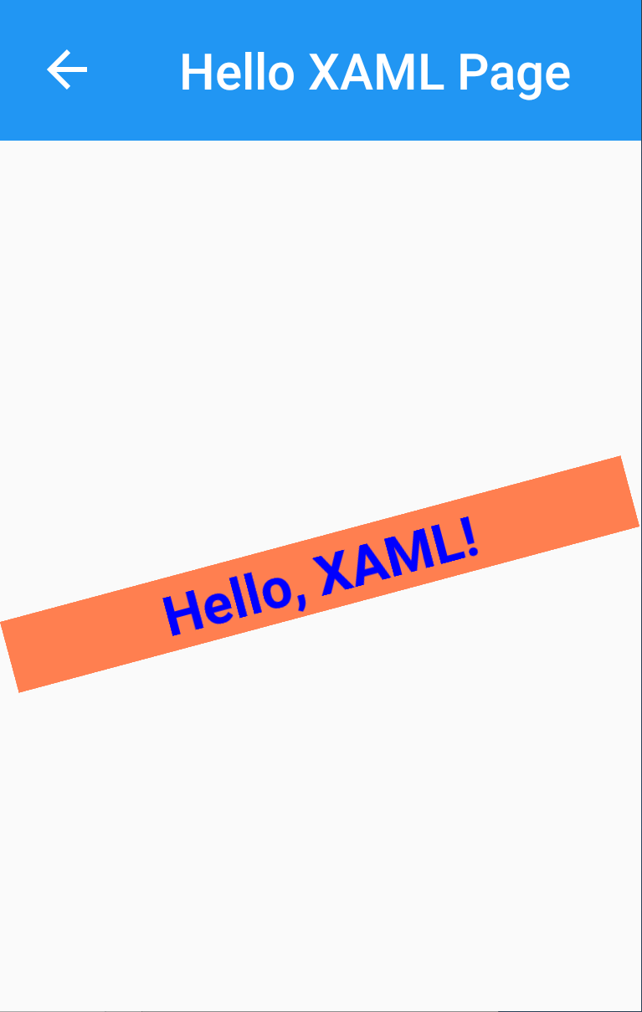
Here it is!

Slide 17
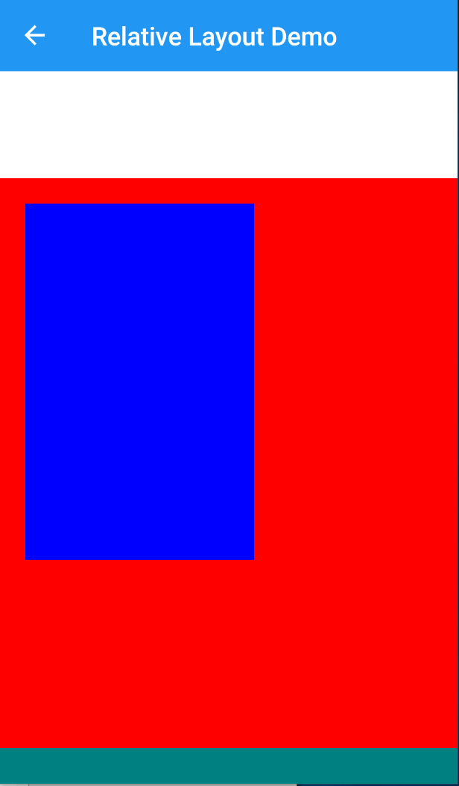
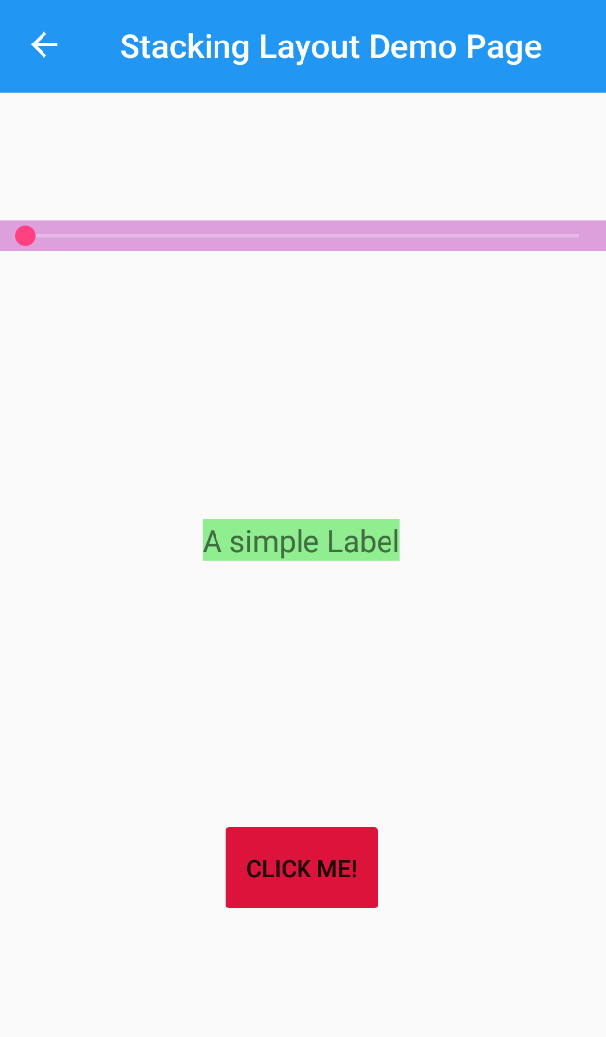
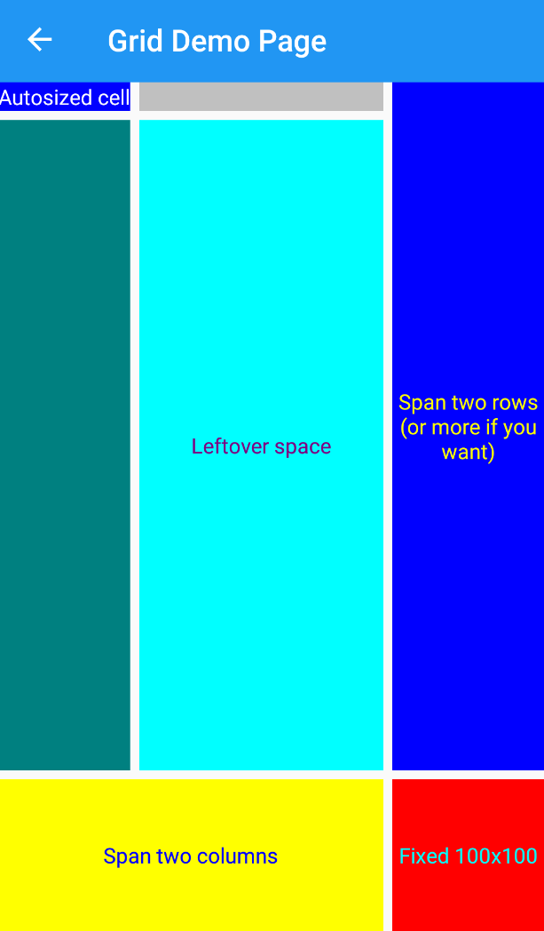

Layout

Slide 18
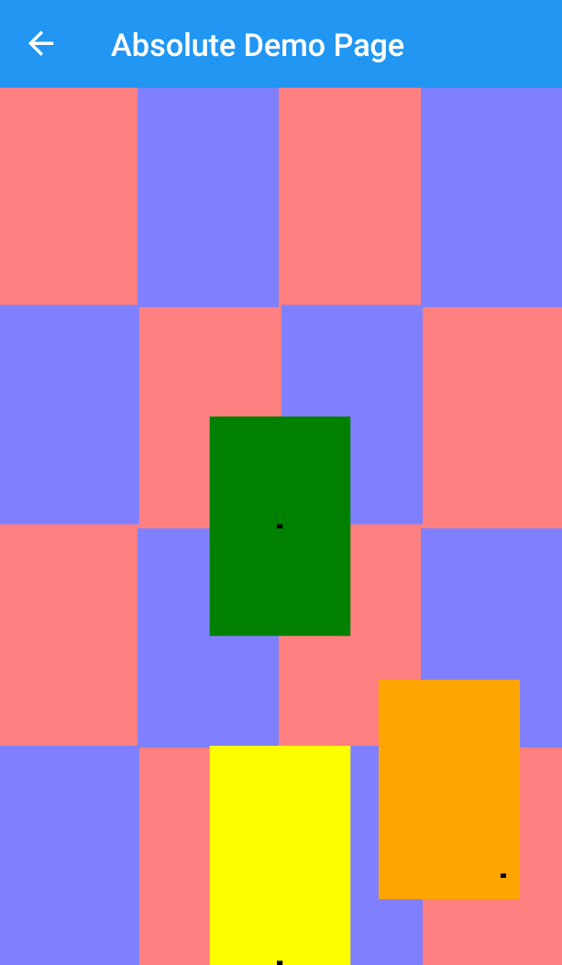
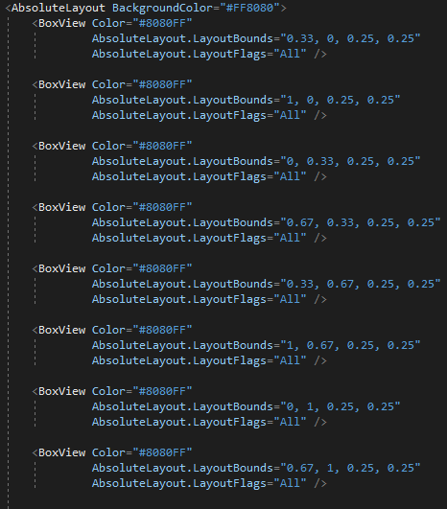
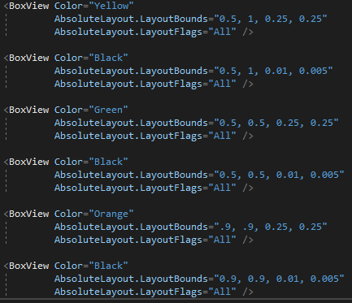
Absolute Layout

Slide 19
Absolute Layout
1.0
(0,0)
.125
(0,0)
1.0
.125
1.0
1.0
.25
.
.25
(0.9, 0.9)
(1,1)
(1,1)

Slide 20
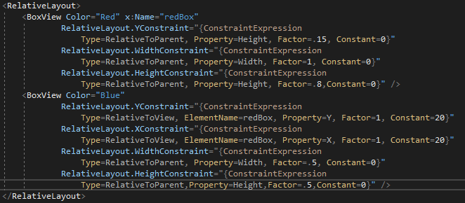
Relative Layout

Slide 21
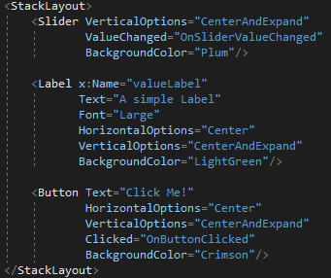
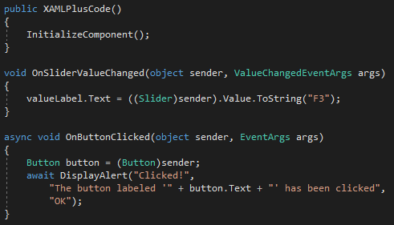
Stacked Layout

Slide 22
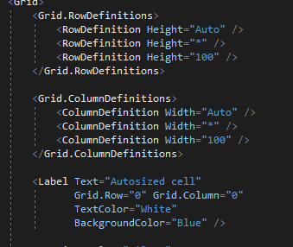
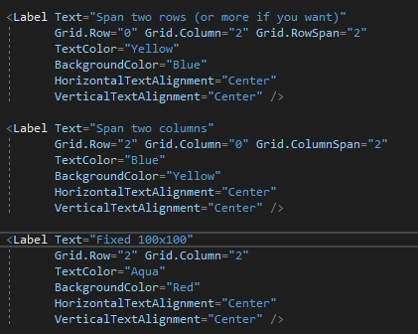
Grid Layout

Slide 23
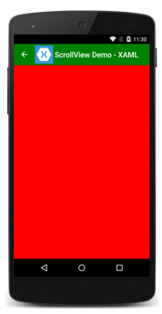
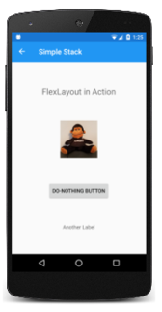
Other Layouts Receiving Votes
ScrollView
FlexLayout

Slide 24
Data Binding
Target property must have inherited from BindableObject
BindingContext must be set on the target object
Set from a StaticResource
Set from x:Static markup extension
Set from the BindingContext property
Multiple Binding Modes
OneWay
OneWayToSource
TwoWay

Slide 25
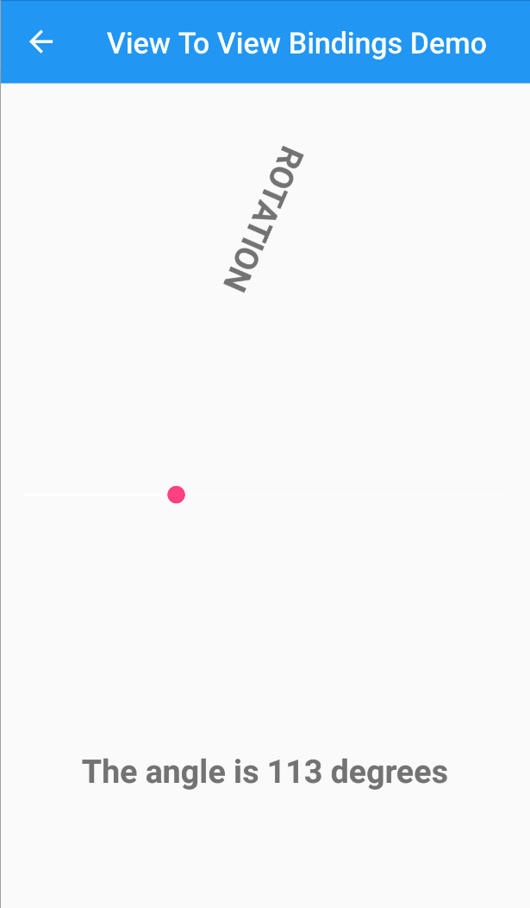
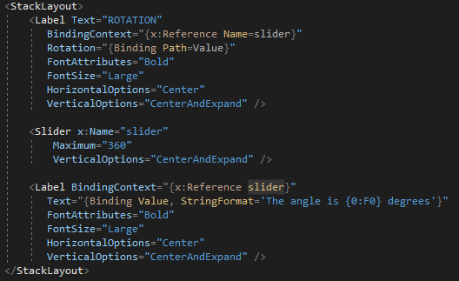
View to View Bindings

Slide 26
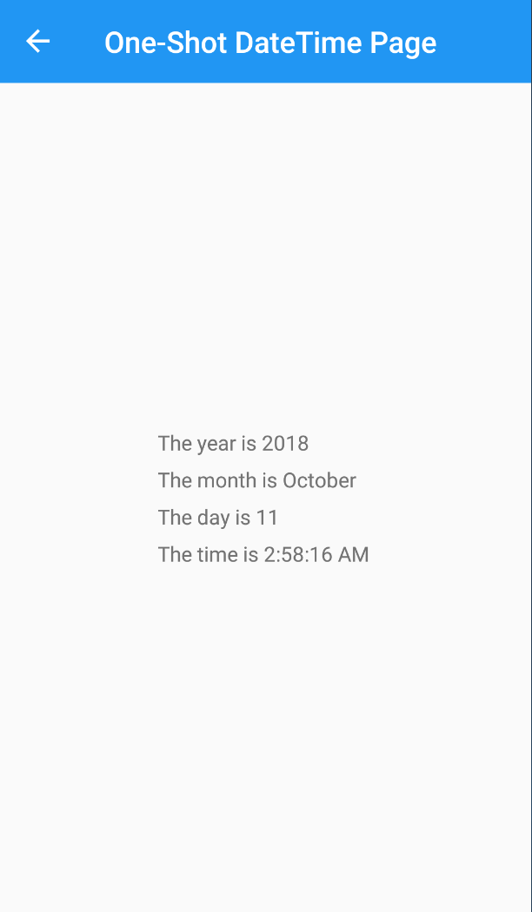
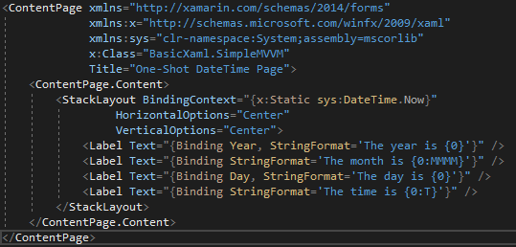
Bindings using ViewModel Pattern

Slide 27
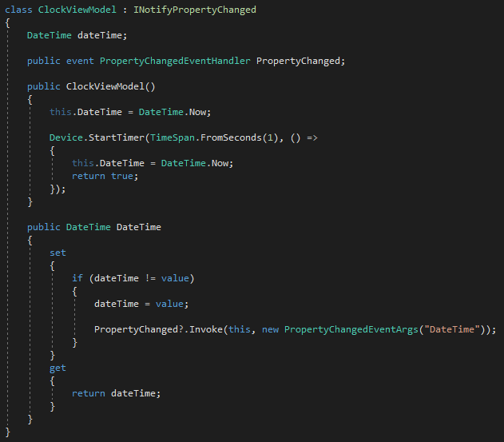
Automatic UI Refreshed ViewModel
UI is refreshed when a PropertyChangeEvent is invoked
Implement the INotifyPropertyChange interface
Execute Invoke on the PropertyChangeEventHandler

Slide 28
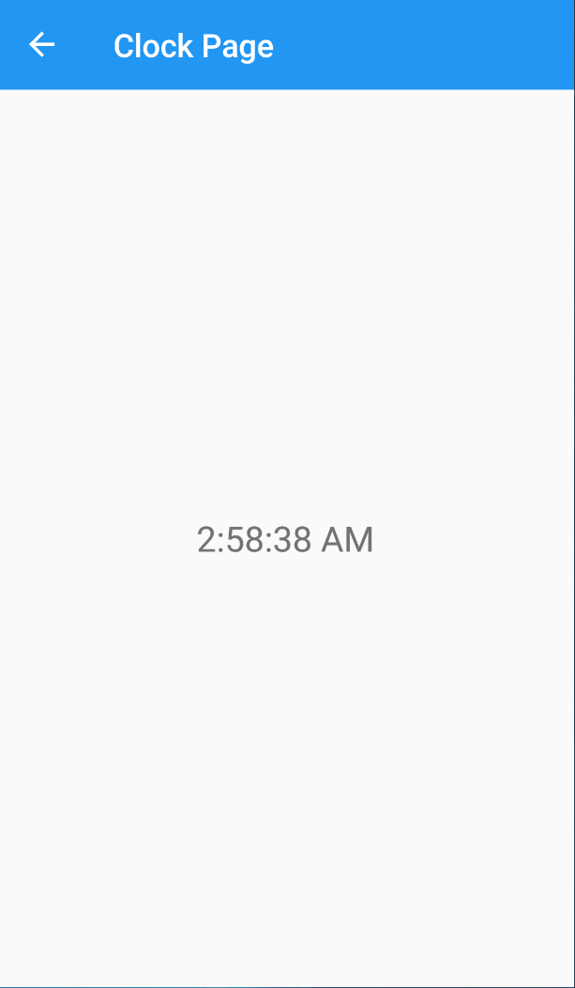
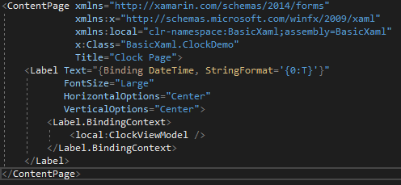
Automatic UI Refresh with ViewModel

Slide 29
Review
MV * Patterns
MVC
MVP
MVVM
XAML
Basics
Navigations
Layouts
Data Binding and View Refresh

Slide 30
Questions
https://docs.microsoft.com/en-us/xamarin/xamarin-forms/xaml/xaml-basics/
https://github.com/ashjonm/XamarinXAMLBasics

